Slide 1

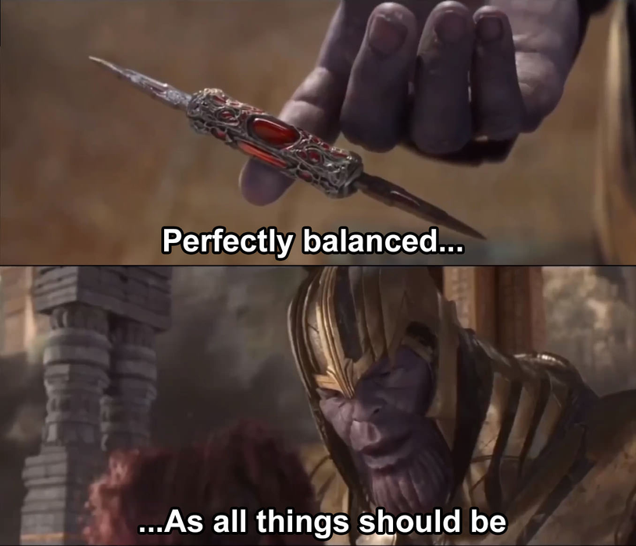
Thanos
A Stack Balancing Robot
Table of Contents
Background
Objective
Robot & Environment Dynamics Modelling
Controller Design
Simulation
DWARAKESH RAJESH

Slide 2

Background: Balancing Robots
BALANCING ON ROBOT
BALL BALANCING ROBOT
OBJECT BALANCE
(OUR FOCUS)
BALANCE
SPOT/ATLAS
BALANCING THE ROBOT
BALLBOT
SELF-BALANCE
EVOBOT

Slide 3

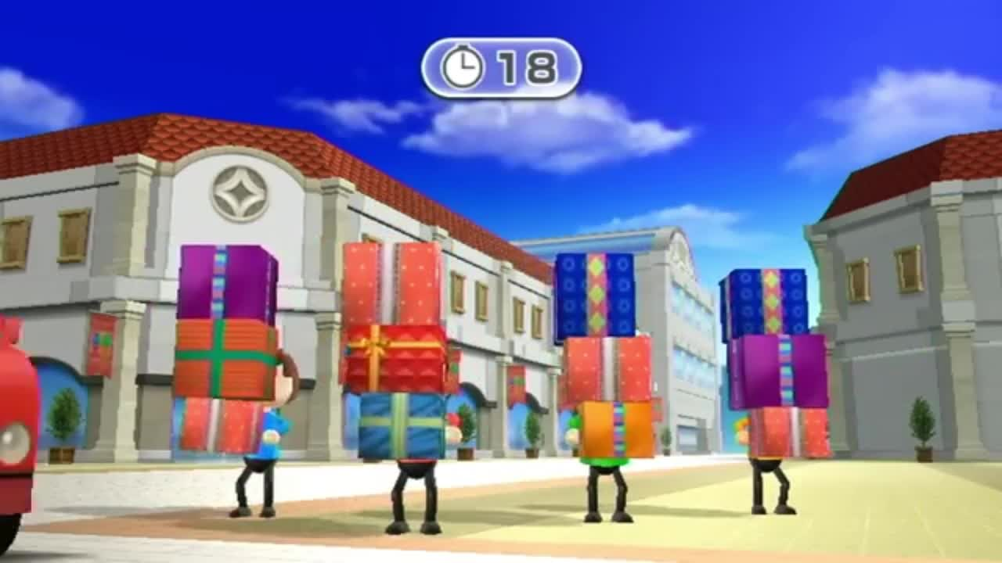
Objective:
If we can balance a ball, we can balance a box too. What about boxes, a tower of boxes?
Notes:
Add dynamics model picture
and explain

Slide 4

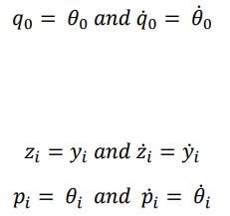
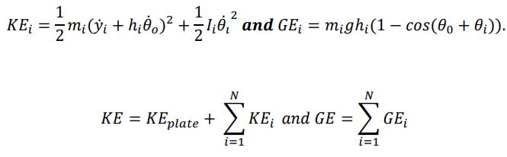
Consider two ways to model the environment:
The whole stack is treated as one object → Approximation
One link → Inverted Pendulum Problem
Each box on stack has its own dynamics → Truth
Each box is affected by the wind force differently due to dimensions, mass and friction coefficients.
So multiple links, one actuator → Underactuated Control Problem
Robot and Environment Dynamics Modelling
Robot dynamics
Limitation: A tilting plate that tilts about the Y axis
Mass (M)
Tilt angle (theta)
Motor Torque (tau) - controlled input
Environmental dynamics
Assumption: The wind only blows horizontally (as seen in the game before)
Dynamics to consider:
Friction between the boxes (static and kinetic friction),
Wind force,
Mass of boxes (m_i)
Gravity (g) = 9.81
Can this system achieve stability? Global asymptotic stability at origin. (Shown in image)
*ALL VARIABLES ARE IN SI UNITS

Slide 5
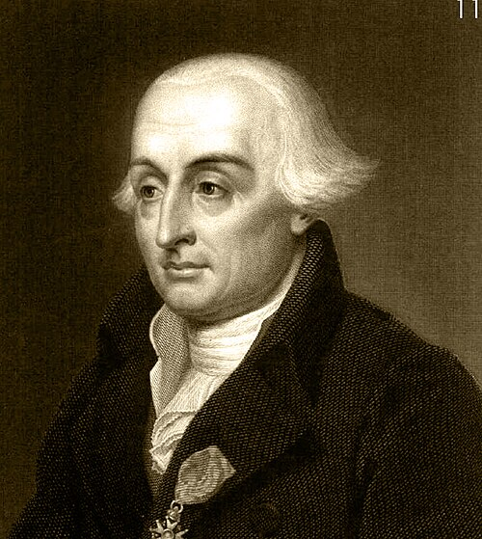
Lagrangian Dynamics
JOSEPH-LOUIS LAGRANGE

Slide 6
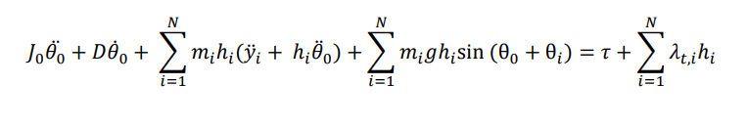
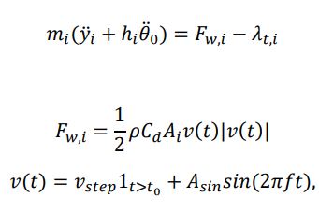


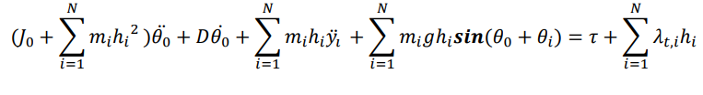

Lagrangian Equations:
PLATE LAGRANGIAN EQ
BOX SLIDE & WIND FORCE
BOX PITCH
COMPLEMENTARITY
COMPLETE LAGRANGIAN EQUATIONS
STATE-SPACE FORM
*ALL VARIABLES ARE IN SI UNITS

Slide 7

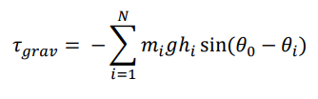

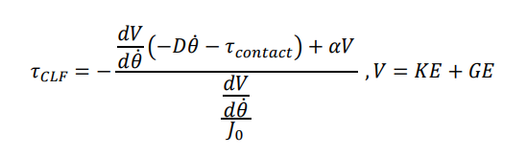
Controller Design
2 controllers & initial stabilizer in play:
Gravity Feedforward:
To account for any gravitational torque/moment due to initial misalignment of boxes on stack.
Linear Controller : PD
To maintain stability under small tilts/perturbations
Wind force < static friction → Region of Attraction
Non-linear Controller : CLF-QP
To maintain stability on tilts past the Region of Attraction
Wind force > static force → slippage occurs/slippage about to occur and eventually topple
Objective → Avoid topple
*ALL VARIABLES ARE IN SI UNITS
Notes:
Add controller equations, and explain

Slide 8

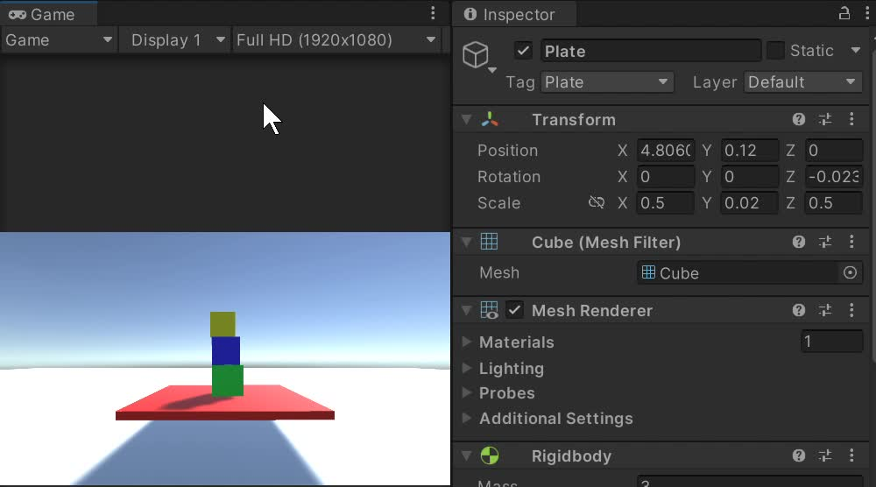
Simulation:

Slide 9

References
Reference
Reference
Reference
Reference
Reference
1
2
3
4
5
Nagarajan, Umashankar & Kantor, George & Hollis, Ralph. (2013). The ballbot: An omnidirectional balancing mobile robot. The International Journal of Robotics Research. 33. 917-930. 10.1177/0278364913509126.
A. D. Ames, K. Galloway, K. Sreenath and J. W. Grizzle, "Rapidly Exponentially Stabilizing Control Lyapunov Functions and Hybrid Zero Dynamics," in IEEE Transactions on Automatic Control, vol. 59, no. 4, pp. 876-891, April 2014, doi: 10.1109/TAC.2014.2299335.
Nonlinear systems. Khalil & K, H. Prentice Hall, Upper Saddle River, N.J., 2002.
Yuquan Wang, Niels Dehio, and Abderrahmane Kheddar, “On Inverse Inertia Matrix and Contact-Force Model for Robotic Manipulators at Normal Impacts,” IEEE Robotics and Automation Letters, vol. 7, no. 2, pp. 3648–3655, Apr. 2022. DOI: 10.1109/LRA.2022.3145967.

